Slide 1


Global Semiconductor Cluster & Emerging AI
- A Snapshot
Clustiv Team
29 July 2023

Slide 2
AGENDA
1
2
3
4
5
EU Market share in Value chain
Fab Clustering
Benefit of Clusters
in Semiconductors
Smart Fab & Manufacturing
R&D Design cost &
Fab Module cost
6
7-8
9
10
11-12
Supply Chain
&
Value Chain
Global Fab Investment
Process Node
OSAT
AI & Cost of Fab Construction
Artificial
Intelligence
13
Chip Design and Manufacturing Cost

Slide 3
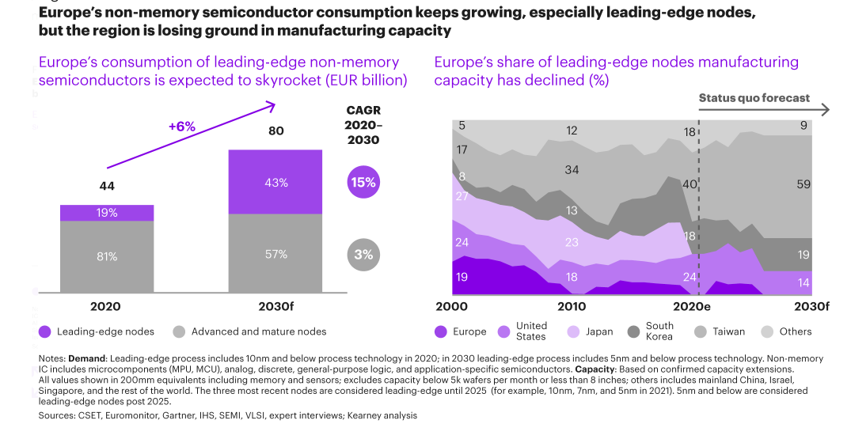
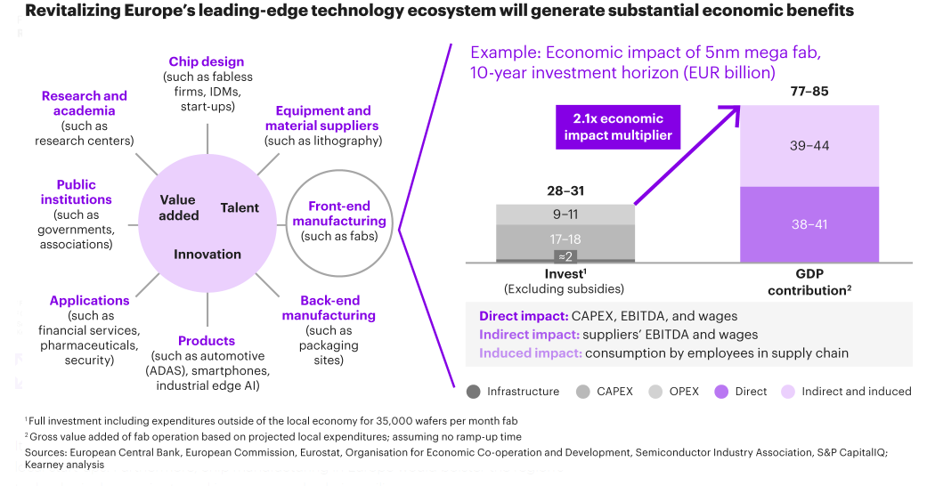
1
Fab clustering
When building a fab, location is one of the most important considerations. Whenever possible, semiconductor players should try to place new facilities in industry clusters—places where several semiconductor companies, or related businesses, have established a strong presence within a relatively small area. These clusters create an environment that encourages collaboration and promotes synergies among companies, even traditional rivals. Cluster participants can achieve a much higher level of performance and greater international visibility than a single company operating independently.

Slide 4
2
Benefit of Clusters in Semiconductors
  Industry clusters develop in places where several semiconductor companies, or related businesses, have established a strong presence:
Within the United States, for instance, clusters exist in Silicon Valley, Phoenix, upstate New York, and Austin for chip manufacture and equipment. Other clusters include those in China, Germany, Japan, Singapore, South Korea, and Taiwan.
Provide constellation that attracts small-to-medium enterprises and eventually creates an ecosystem to support research and manufacturing.
Gaining access to global talent
The risk of supply-chain disruptions is also lower if companies are receiving components or other inputs from nearby vendors.
1
2
3
3
4

Slide 5
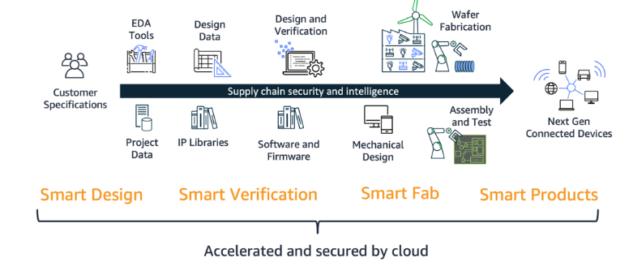
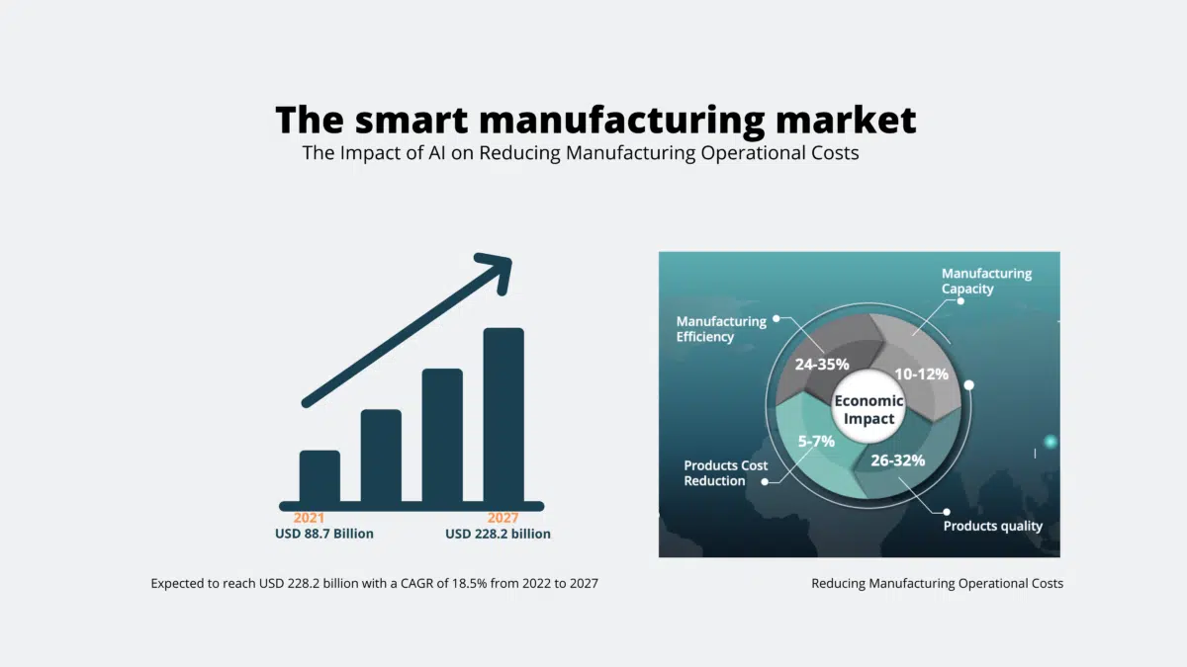
3
Smart Fab for Semiconductors
Smart Manufacturing Market
Semiconductor Supply Chain
Smart Fab also extends beyond today’s typical approach to optimize capital expenditure (CAPEX), time to market, design quality, and advanced technology device fabrication. It focuses on continuous operational expenditure (OPEX) improvements across all fab operations, in addition to CAPEX optimizations, TTM, and quality. Secure access to data throughout the supply chain makes this possible with cloud-based collaboration, Internet of Things (IoT) technologies, AI/ML, and advanced analytics.
Source: amazon blogs

Slide 6
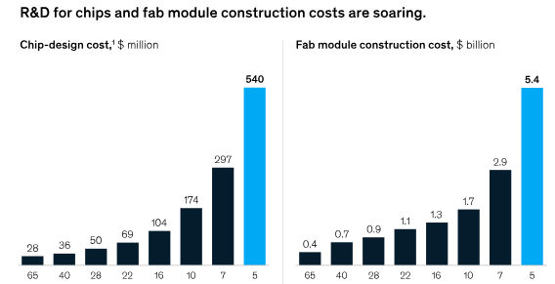
4
Process
Nodes

Slide 7
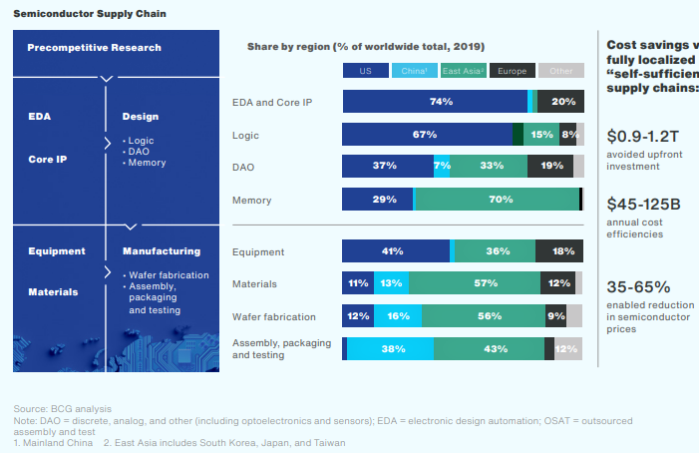

5
EU‘s market share is behind in the two most value-adding segments of semiconductor value chain

Slide 8
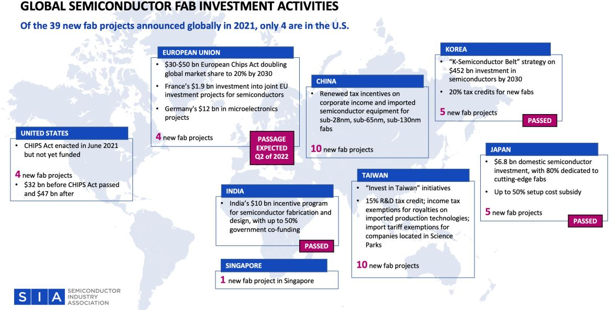
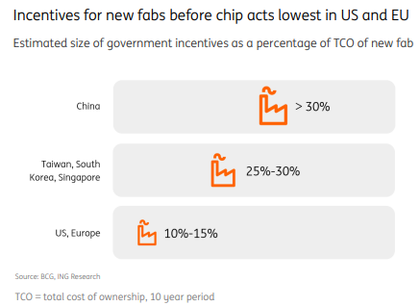
6
Fiscal support of 50 percent of project cost on Pari-passu basis for all technology nodes under Scheme for Setting up of Semiconductor Fabs in India.
Fiscal support of 50 percent of project cost on Pari-passu basis under Scheme for Setting up of Display Fabs.
Fiscal support of 50 percent of capital expenditure on Pari-passu basis under Scheme for Setting up of Compound Semiconductors / Silicon Photonics / Sensors Fab and Semiconductor ATMP /OSAT Facilities in India. Additionally, target technologies under the Scheme will include discrete semiconductor fabs.

Slide 9
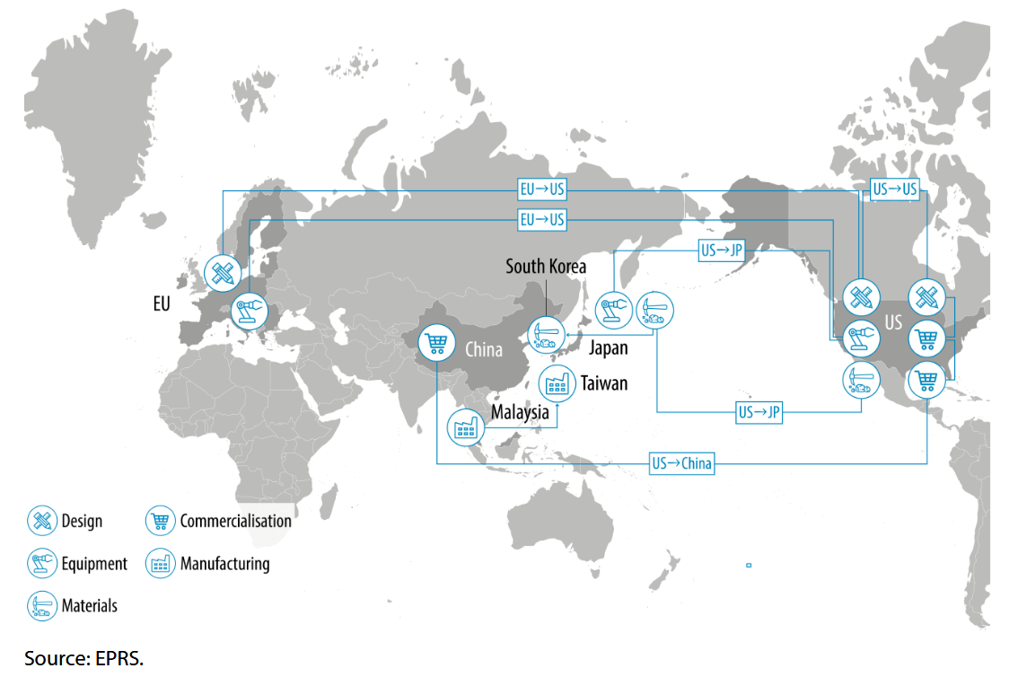
7
The Global Semiconductor Supply Chain

Slide 10
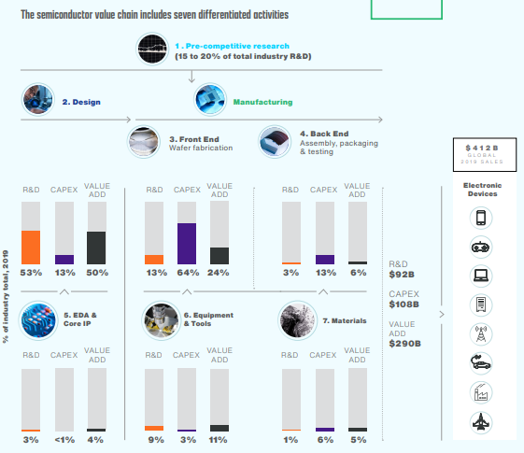
8
The semiconductor value chain includes seven differentiated activities

Slide 11
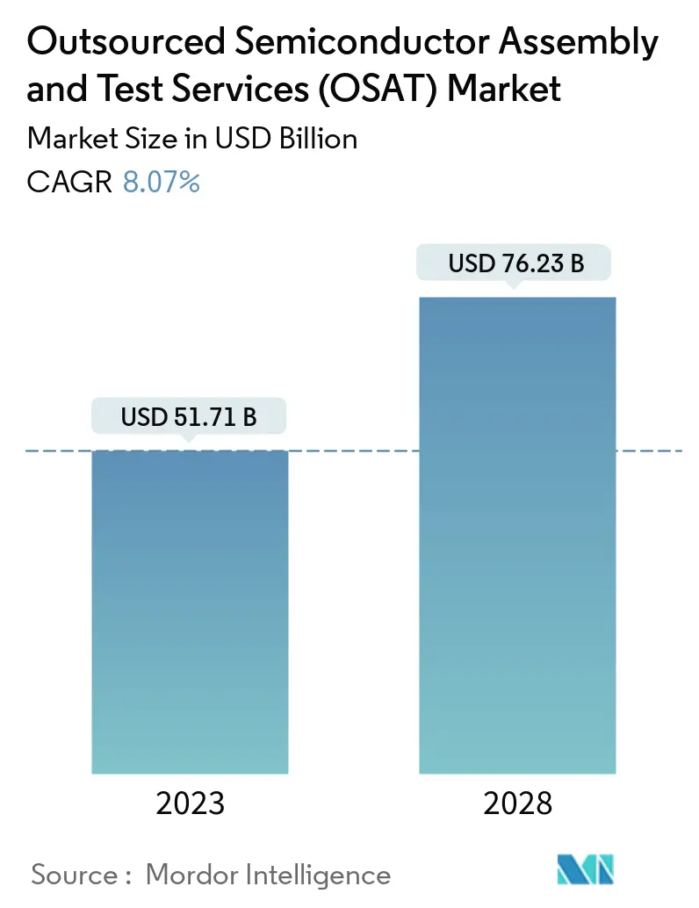
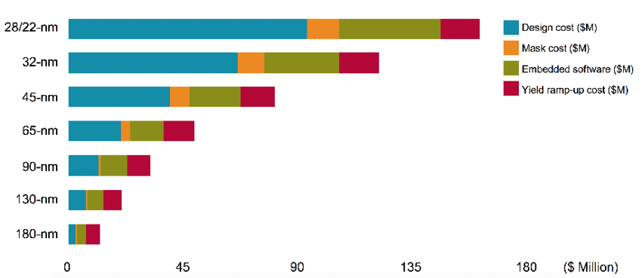
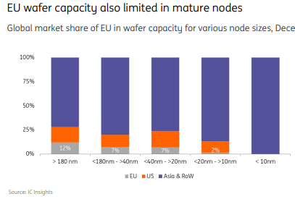
9
BGA, Quad & Dual contributes approx. 70% share in Packing Type.
multi-package segment generated a substantial revenue share in OSAT (SiP/MCM)
ASIA is dominant market

Slide 12
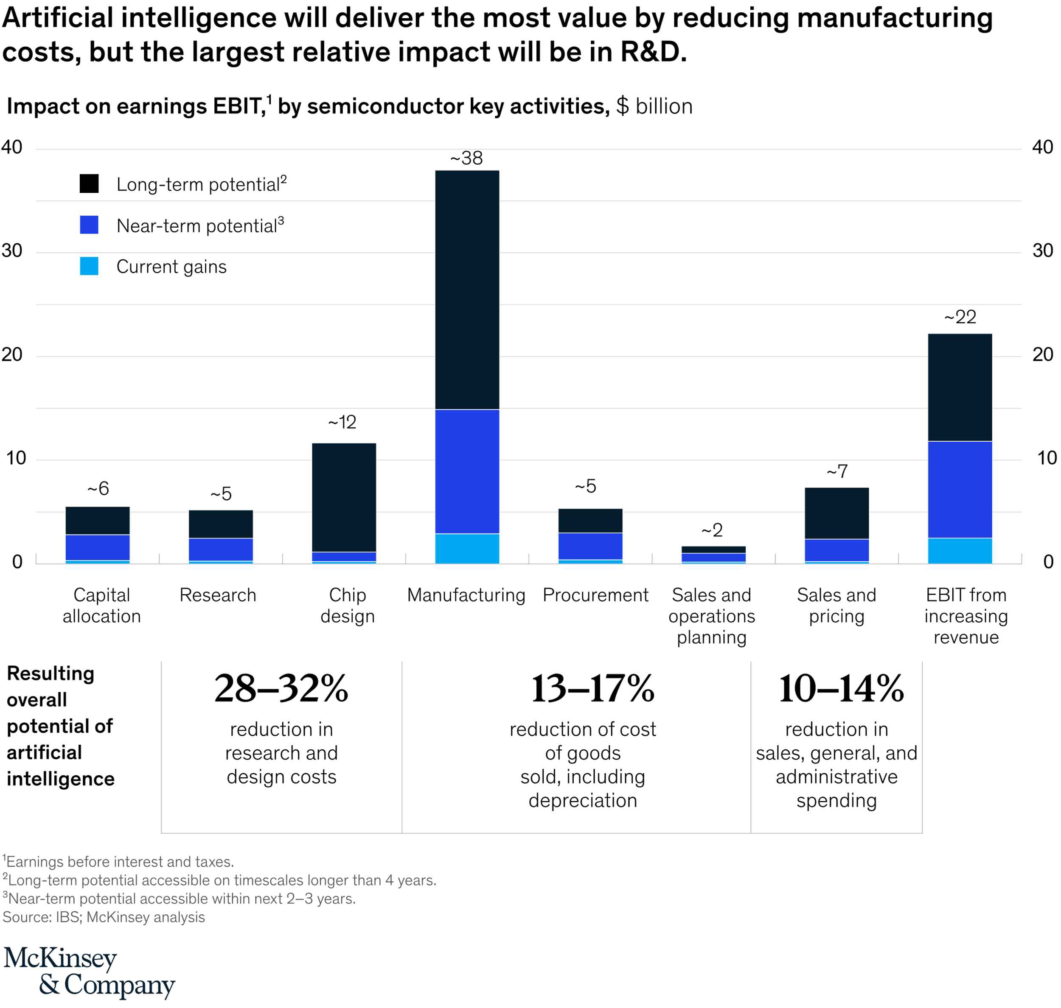
10
AI will deliver the most value by reducing manufacturing cost, but the largest relative impcact will be R&D

Slide 13
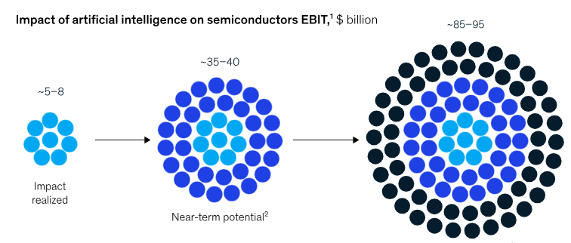
11
AI could generate $85 billion to $95 billion for semiconductor companies over the long term
In 2-3 Years
In 4 Years more

Slide 14
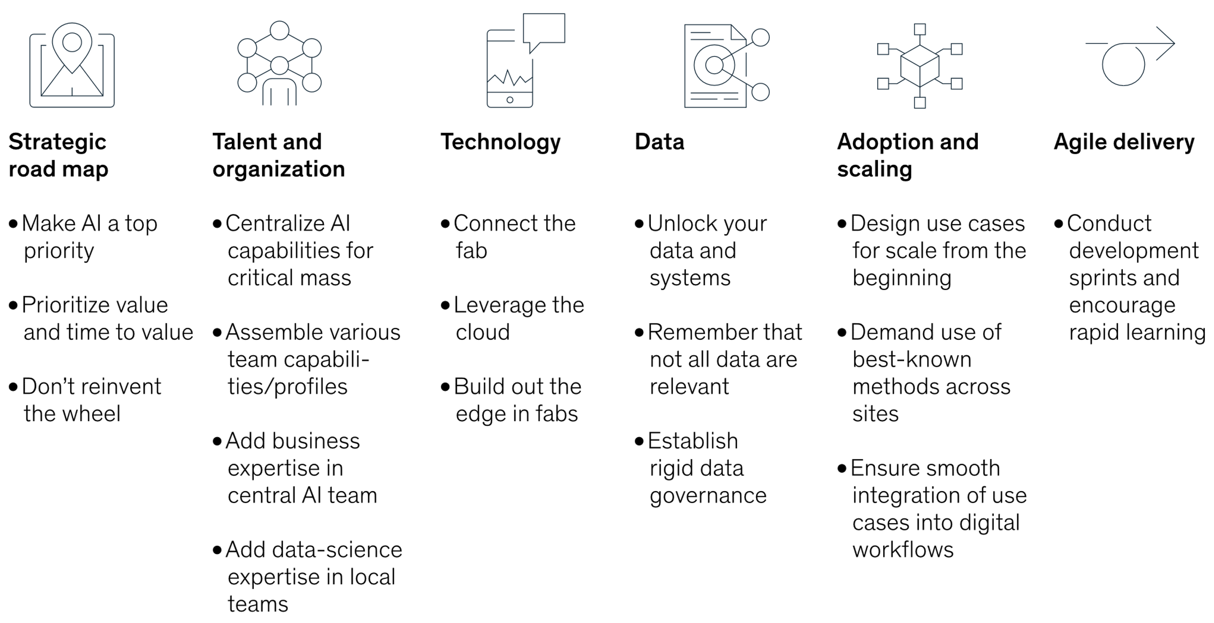
12
Six critical enablers for successful AI/ML implementation at scale
*Mckinsey

Slide 15
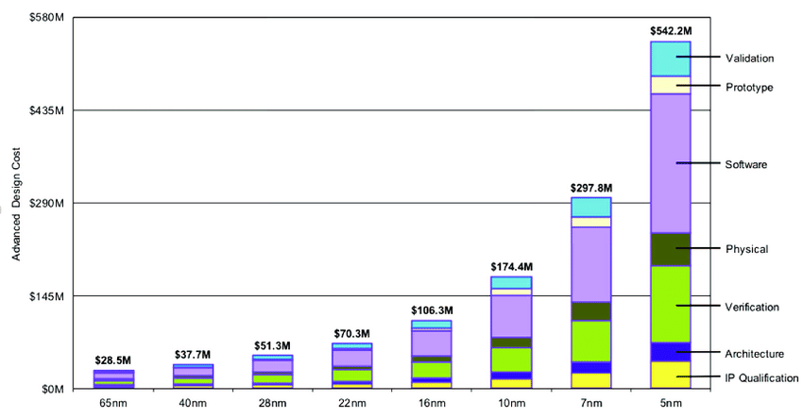
13
Chip Design and Manufacturing Cost under Different Process Nodes
With the evolution of chip manufacturing process, the overall chip design cost has increased signiﬁcantly due to the more complicated process and more difﬁcult design and Implementation.
Increase of design cost for each generation technology has exceeded 50% after 22 nm process, including EDA, design veriﬁcation, IP core, tape-out, and so forth.
For instance, the total design cost of 7 nm process is about 300 million dollars, and that of 3 nm process is expected to increase 5 times up to 1.5 billion dollars.
Thus, the difﬁculties for implementing a high-performance chip upgrade based on process improvement are increasing and
the price-performance ratio is increasing. Furthermore, due to the technical limitations in yield (such as the mask size of lithography machine),
the existing monolithic integration becomes unsustainable with new process for upgrading and expanding the functions and performance.
In such a scenario, chiplets provide a feasible way for future chip design. Multi-Chip Modules
(MCM) technology . MCM technology connects multiple chips on a substrate or other medium for meeting the
performance and functional requirements of complex system chips. MCM could reduce the overhead
of board-level interconnection and the complexity of board-level system design, which saves the cost
of building a system greatly
*IBS (International Business Strategy Corporation)

Slide 16


