Slide 1
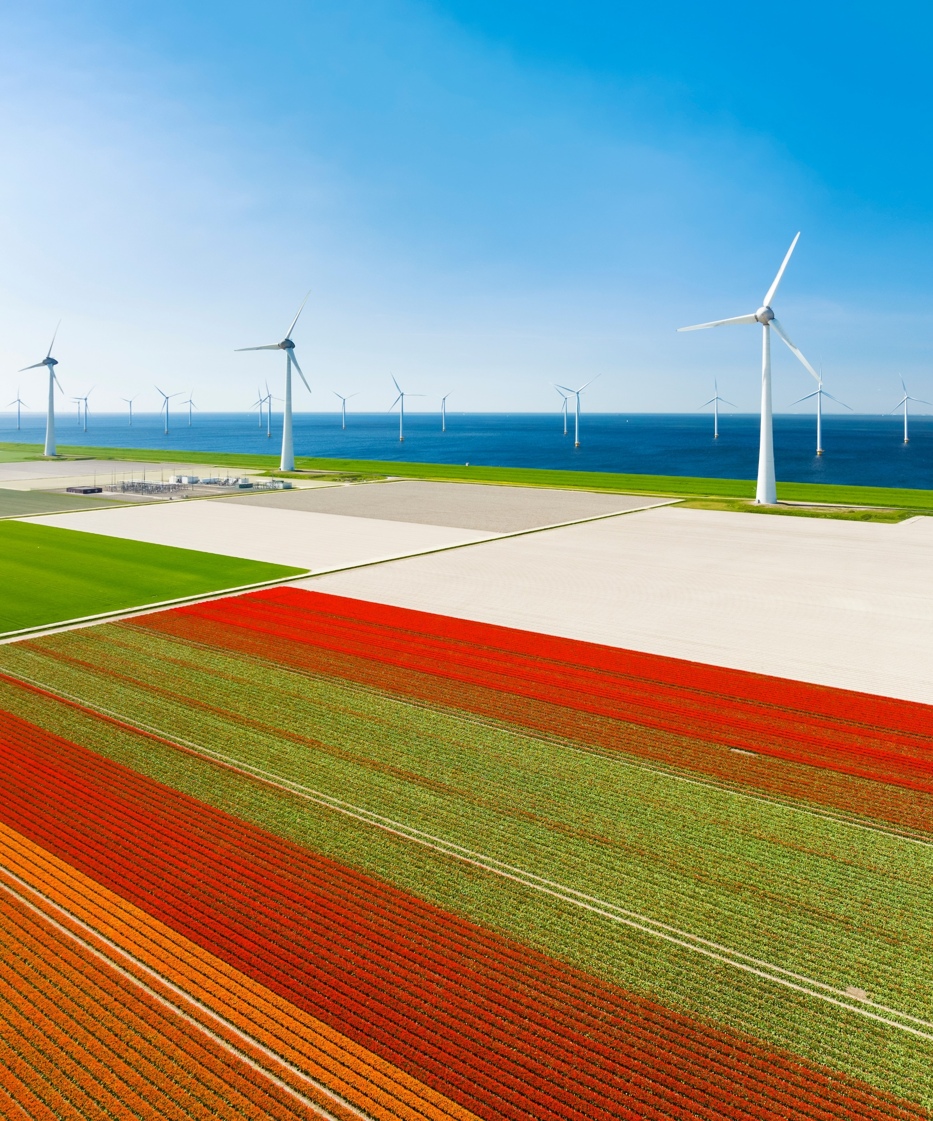

Global Energy
Business & Technology
Continued.....
01 August 2023

Slide 2
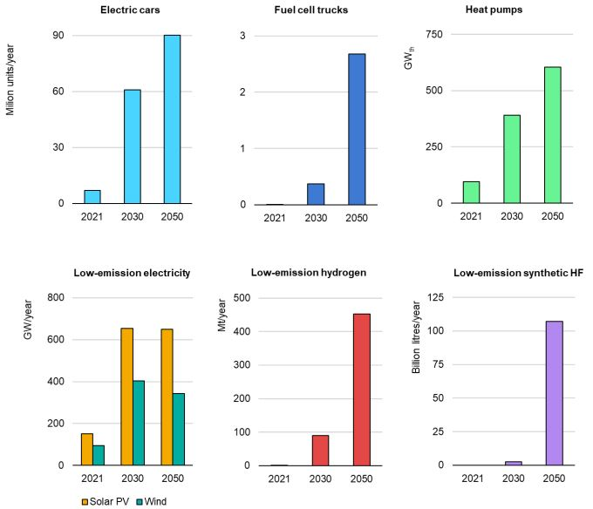
Global supply gap with the NZE Scenario and geographic concentration by stage and technology based on expansion announcements, 2030
1
Getting to net zero is not possible without more innovation
2
Global production of electric vehicles (EVs) (excluding two- and three-wheelers) increases 15-fold to 2050, while the deployment of renewables nearly quadruples.
3
The NZE Scenario requires a shortening of innovation cycles, which can be partially achieved by improving the commercial advantage of clean energy technologies. There are several promising projects seeking to address pressing innovation gaps in a broad range of technology areas, but they need to progress quickly to play a major role in the next three decades. Global co-operation and international knowledge transfer, as well as tracking progress,
Source: IEA
Notes: The gap is defined as the difference between required production in the NZE Scenario and projected production taking into account current production and announced expansion plans, expressed as a share of the former. The regions/countries included in this analysis are Africa, Other Asia Pacific, China, Europe, Eurasia, North America, Central and South America, and the Middle East. Gas-CCS H2 = natural gas-based hydrogen production with carbon capture and storage. Synthetic HC fuels = low-emission synthetic hydrocarbon fuels. Sources: IEA analysis based on company announcement. IEA (2021b); USGS (2022); S&P Global (2022a); S&P Global (2022b); S&P Global (2022c); S&P Global (2022d); EC (2020); Fraser et al. (2021); Infolink (2022); BNEF (2022); BNEF (2020). Also see the Annexes to this report.

Slide 3
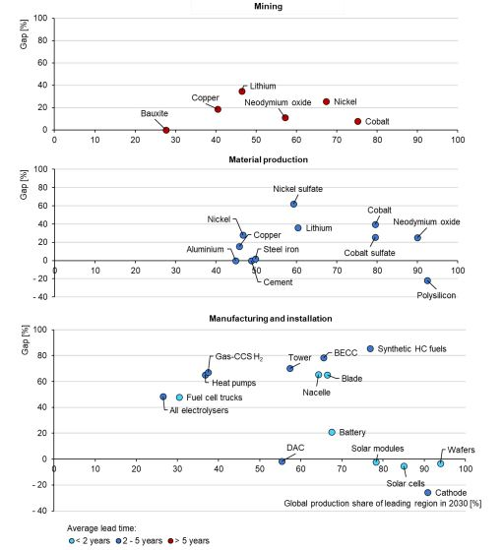
Global supply gap with the NZE Scenario and geographic concentration by stage and technology based on expansion announcements, 2030
1
Current expansion announcements point to large production gaps for some clean energy supply elements, notably lithium, nickel and copper mining and processing.
2
The supply gap is significantly higher for electrolysers at about 50%, and up to over 60% for heat pumps and bioenergy with carbon capture (BECC). Expected production capacity is more evenly distributed geographically for electrolysers and heat pumps, but highly concentrated for BECC
Source: IEA
Notes: The gap is defined as the difference between required production in the NZE Scenario and projected production taking into account current production and announced expansion plans, expressed as a share of the former. The regions/countries included in this analysis are Africa, Other Asia Pacific, China, Europe, Eurasia, North America, Central and South America, and the Middle East. Gas-CCS H2 = natural gas-based hydrogen production with carbon capture and storage. Synthetic HC fuels = low-emission synthetic hydrocarbon fuels. Sources: IEA analysis based on company announcement. IEA (2021b); USGS (2022); S&P Global (2022a); S&P Global (2022b); S&P Global (2022c); S&P Global (2022d); EC (2020); Fraser et al. (2021); Infolink (2022); BNEF (2022); BNEF (2020). Also see the Annexes to this report.

Slide 4
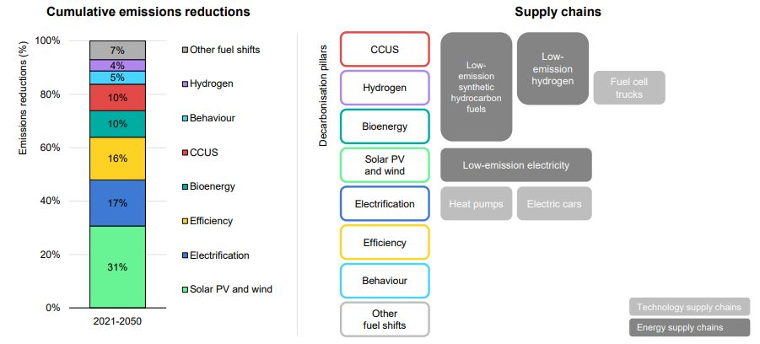
Global cumulative energy sector CO2 emissions reductions by decarbonization pillar and clean energy and technology
supply chains 2021-2050
1
Six clean energy and technology supply chains hold the potential to unlock around 50% of cumulative emissions reductions to 2050 in the NZE Scenario
2
Above energy and technology supply chains are specific to a particular pillar, such as electric cars and heat pumps for electrification, fuel cell trucks for hydrogen, or solar PV and wind. Some are more cross-cutting in nature, such as low-emission hydrogen and low-emission synthetic hydrocarbon fuels.
Source: IEA
Notes: “Other fuel shifts” include other renewables, nuclear, and switching from coal and oil to natural gas. “Behaviors” includes energy service demand changes from user decisions (e.g. changing heating temperature), as well as avoided demand, which refers to energy service demand changes from technology developments (e.g. digitalization)

Slide 5


